Slide 1
The library application
Oren Eini
Orene@we-can.co.il

Slide 2
What have we done so far?
Database
Transactions
Delegates & Events
Generics
Primary Key Selection Strategies
How to structure a database
Separation of Concerns
Testing
Whole lots of bugs ☺

Slide 3
User Interface
Select Options View
Add User View
Controllers
Main Controller
Add User Controller
Business Layer
Entities
Book
User
Services
Library
Data Layer
Books Repository
Users Repository
Stored Procedures
Book Insert
Book Find Available Copy
Tables
Users
Book Catalog
The Database

Slide 4
The database

Slide 5
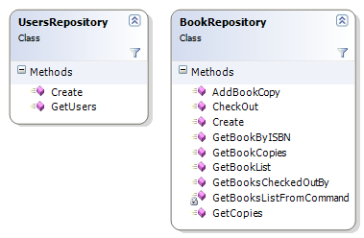
The data layer
Note, that some methods, such as BookRepository.CheckOut do not have a fully working implementation.
With.Transaction pattern, is discussed later

Slide 6
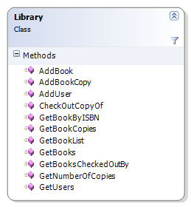
The services
Note, in a real application, we would have the library do much more. For instance, the method Library.CheckOutCopyBook should find out if a copy is available on the library for the specified book, get its id, and then reserve it for the specified user.

Slide 7
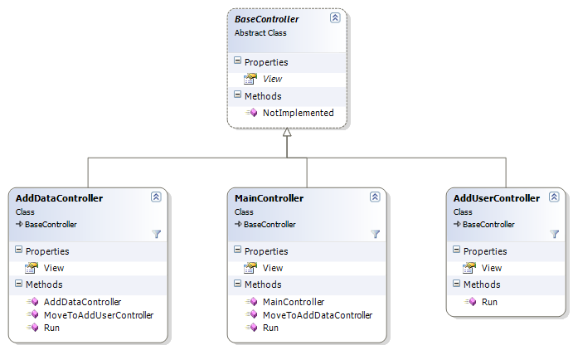
The Controllers

Slide 8
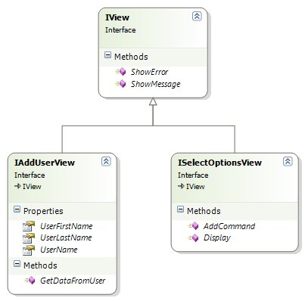
The views - interfaces

Slide 9
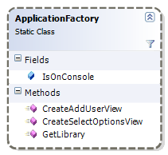
The application factory

Slide 10
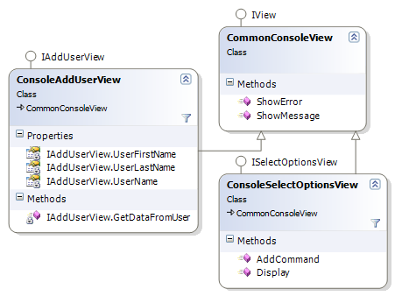
The command line interface

Slide 11
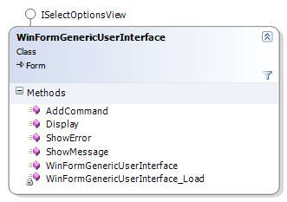
Where we left last time

Slide 12
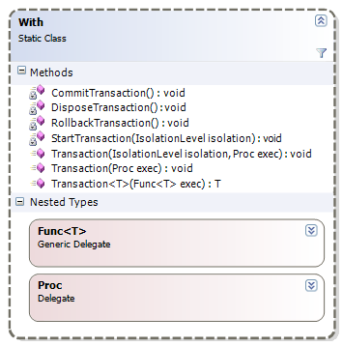
With.Transaction

Slide 13
What are we going to do today?
Questions from last lesson
Home work issues
Fun with generics – BaseController<TView>
Continue to implement functionality
Feedback

